Slide 1
Dynamic Programming
Md. Muktar Hossain
Lecturer
Dept. of CSE
Varendra university

Slide 2
Definition
Dynamic Programming (DP) is a method for solving complex problems by breaking them down into simpler subproblems, solving each of those subproblems just once, and storing their solutions – typically using a technique called memoization or by filling out a table (bottom-up approach).
Dynamic Programming is a strategy for designing algorithm.
» A meta-technique, not an algorithm (like divide & conquer)
» “Programming” in this context refers to a tabular method not to writing computer code.

Slide 3
Key Concepts (when to use DP)
Optimal Substructure: A problem has an optimal substructure if an optimal solution to the problem can be constructed from optimal solutions of its subproblems.
Example:
In the Fibonacci sequence, fib(n) = fib(n-1) + fib(n-2).
In the shortest path problem, the shortest path from A to C via B is the sum of the shortest path from A to B and B to C.
Overlapping Subproblems: A problem has overlapping subproblems if it can be broken down into subproblems that are reused multiple times.
Example:
Computing fib(5) requires fib(3) and fib(4), but fib(3) is also needed in fib(4). Without memoization, this leads to exponential recomputation.
When to not use DP

Slide 4
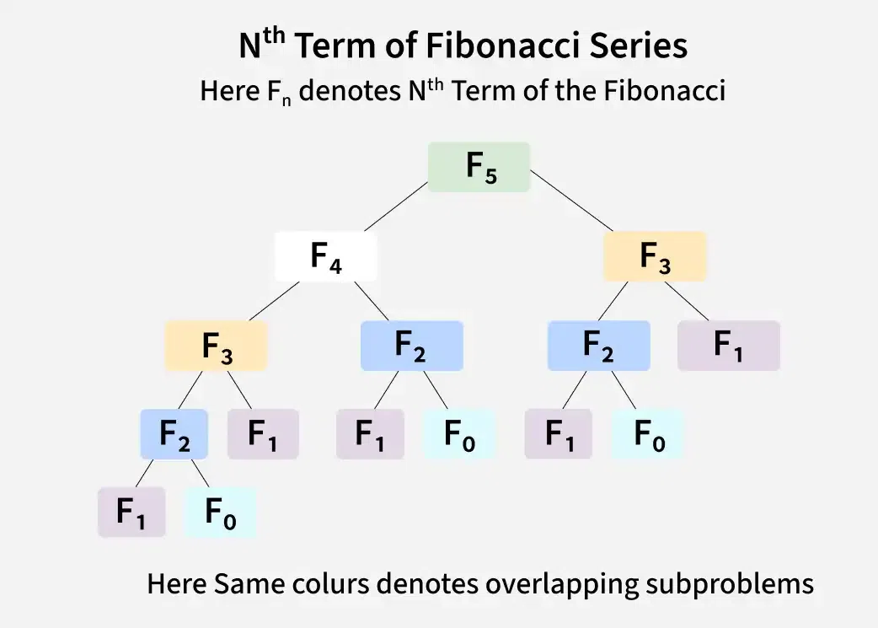
Approaches to DP
Top-Down (Memoization): Use recursion and store (cache) the result of each subproblem so it’s not recalculated.
Example:
FUNCTION FIB(n, memo)
IF n IS IN memo:
RETURN memo[n]
IF n <= 1:
RETURN n
memo[n]← FIB(n-1,memo)+FIB(n-2,memo)
RETURN memo[n]

Slide 5
Approaches to DP
Bottom-Up (Tabulation): Solve all subproblems starting from the smallest, and build up the solution using a table.
Example:
FUNCTION FIB(n)
IF n <= 1:
RETURN n
dp ← ARRAY with values [0, 1]
FOR i FROM 2 TO n:
dp[i] ← dp[i - 1] + dp[i - 2]
RETURN dp[n]
The bottom up tabulation approach
The bottom up tabulation approach
The bottom up tabulation approach
The bottom up tabulation approach
F(0)
F(1)
F(2)
F(3)
F(4)
F(5)
F(8)
F(7)
F(6)

Slide 6
Memoizaton vs Tabulation
Feature | Tabulation (Bottom-Up) | Memoization (Top-Down)
Approach | Iterative | Recursive
Execution Order | Starts from base cases and builds up | Starts from the main problem and breaks down
Function Calls | No function calls (loop-based) | Many recursive calls
Call Stack Usage | No stack used | Uses recursion stack (can cause overflow)
Subproblem Solving | Solves all subproblems | Solves only needed subproblems
Performance | Slightly faster (no recursion overhead) | Slightly slower (recursive overhead)
Space Complexity | O(n) for table | O(n) for cache + O(n) for recursion stack
Best Use Case | When you need all solutions up to n | When only some subproblems are actually needed
Example Use | Bottom-up DP like Fibonacci, LIS, Knapsack | Top-down recursion with memoization in the same problems

Slide 7
DP vs Divide & Conquer
Dynamic Programming solves problems with overlapping subproblems by storing and reusing their solutions.
Example:
Fibonacci with DP: Stores results of previous Fibonacci numbers to avoid recomputation.
Divide & Conquer solves problems with independent subproblems by dividing them recursively and combining the results.
Example:
Merge Sort with D&C: Divides the array into halves, sorts each half independently, then merges them.

Slide 8
DP vs Greedy
Dynamic Programming explores all possible solutions and guarantees an optimal result by solving subproblems and combining them.
Example:
DP (0/1 Knapsack): Considers all combinations of items to get the maximum value within weight limit.
Greedy Method makes locally optimal choices at each step, hoping to reach a global optimum — but doesn't always guarantee it.
Example:
Greedy (Fractional Knapsack): Picks items with the highest value/weight ratio first, assuming it leads to the best result.

Slide 9
Advantages of DP
Avoids redundant computations: Saves time by storing and reusing results of overlapping subproblems(e.g. Fibonacci goes from O(2ⁿ) → O(n)).
Guarantees optimal solutions: Finds the best possible solution for optimization problems.
Improves time complexity: Reduces exponential time complexity to polynomial time (e.g., Knapsack: O(2ⁿ) → O(n×W)).
Solves complex optimization problems: Effectively handles problems like shortest paths, knapsack, and more.
Supports both memoization and tabulation: Offers flexibility in choosing recursive (top-down) or iterative (bottom-up) approaches.
Can be space optimized: Reduces memory usage in some cases, especially in problems with limited state space.
Widely applicable: Works for a wide range of problems across various domains like strings, graphs, and AI.
Reduces recursion depth: Iterative DP can avoid deep recursion and stack overflow issues in recursive solutions.

Slide 10
Thank You

